Slide 1
NBA Playoffs
Derek Yu and Lorenzo Llamas

Slide 2
What we wanted to do!
Something :
Interactive
Visualizes the Playoffs
Fans might like

Slide 3
First Thoughts:
Show how well famous players are doing
Show videos of famous players in a different way
Show yourself as a famous player

Slide 4
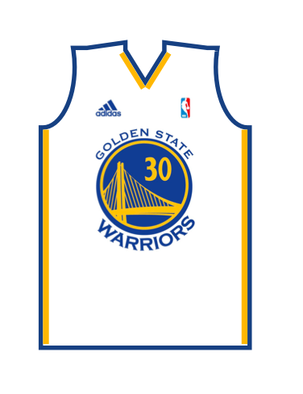
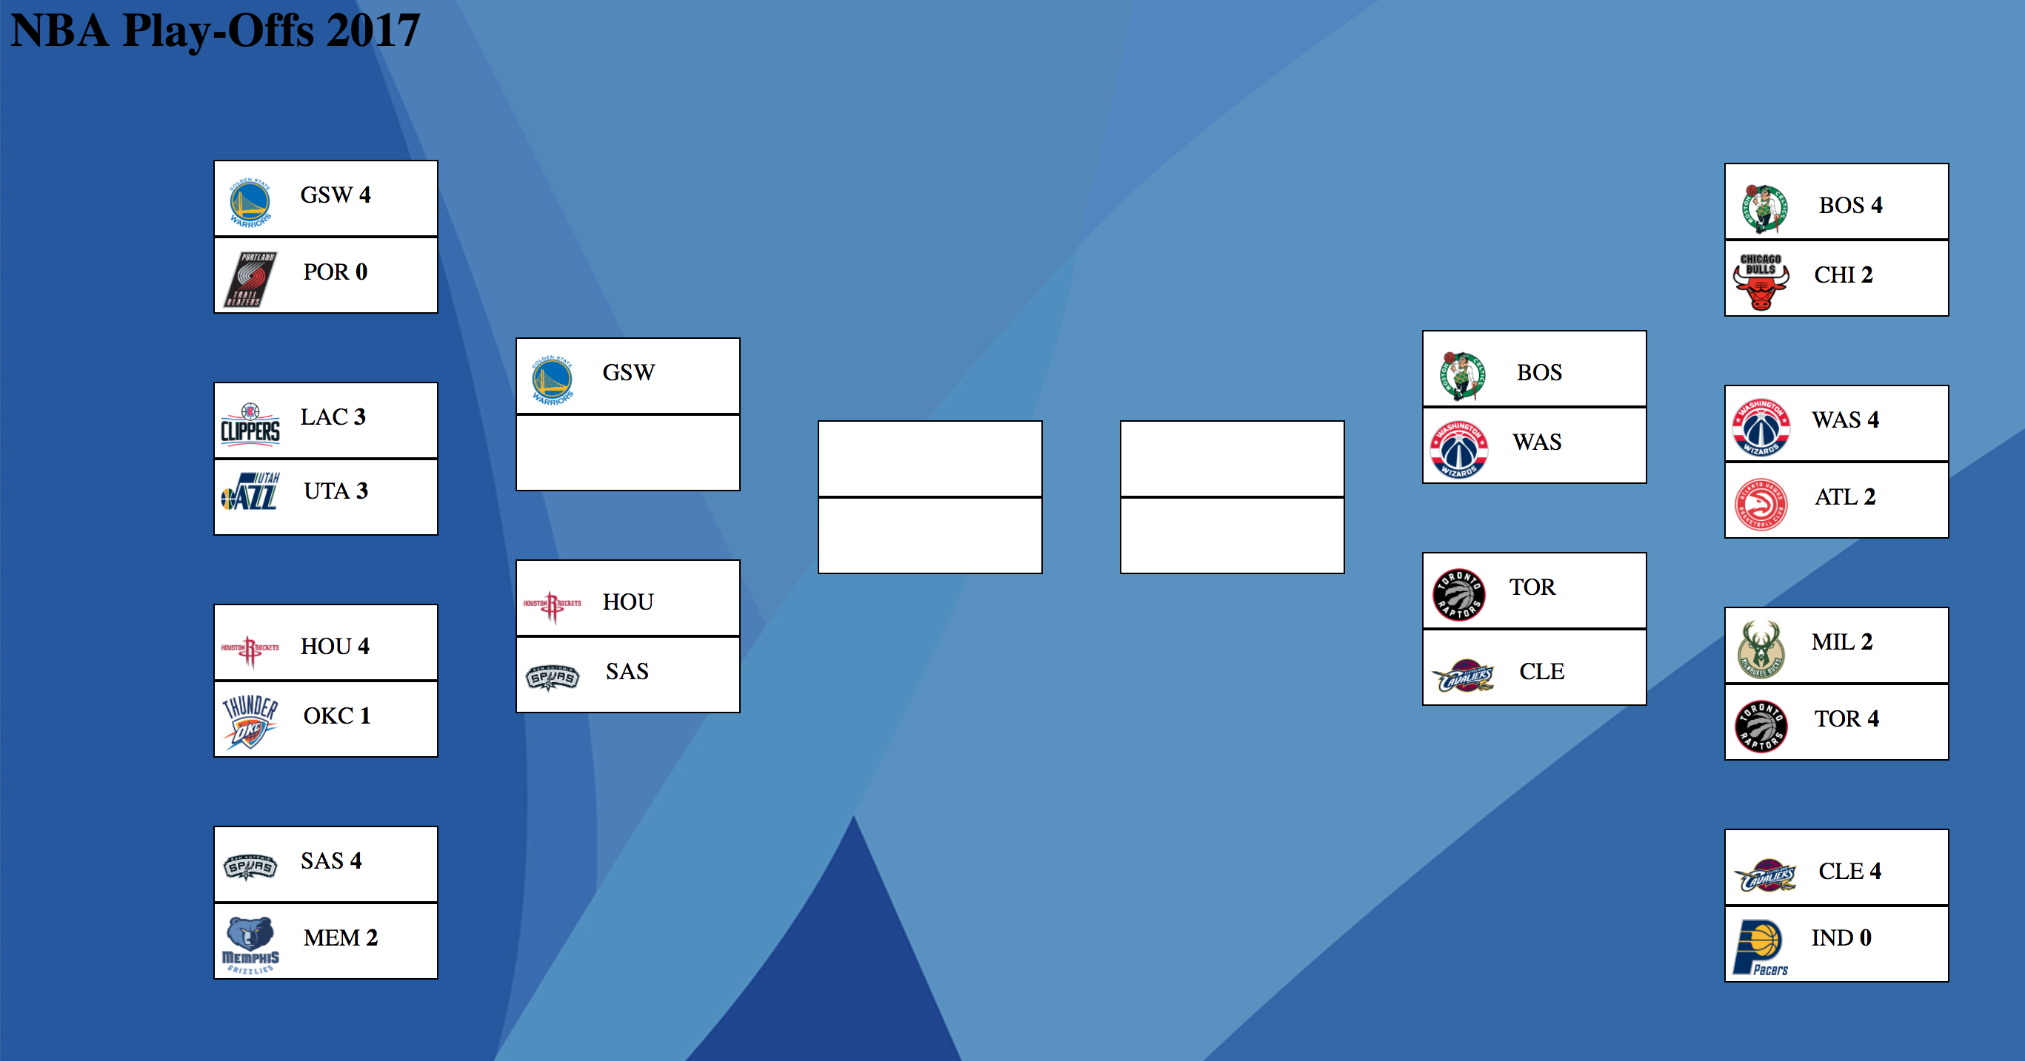
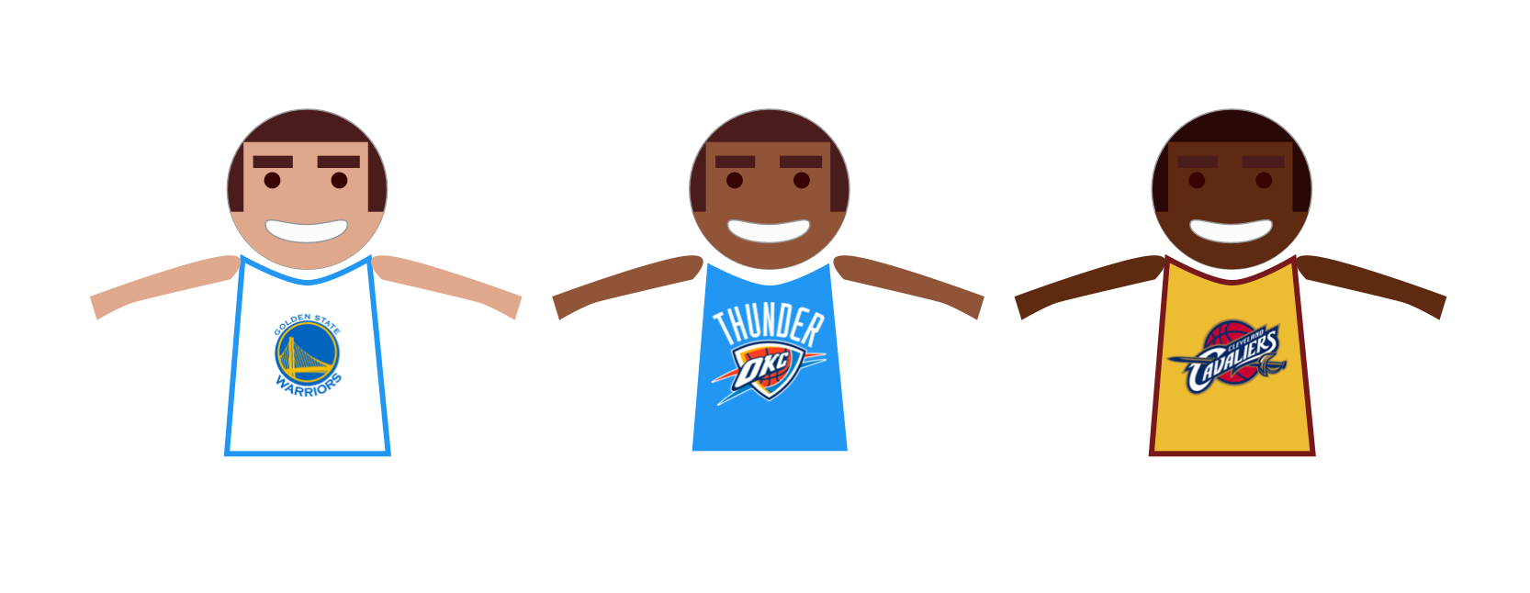
Work:

Slide 5
What we used:
HTML
CSS
JS
p5.js

Slide 6
Demo:
https://i6.cims.nyu.edu/~ddy214/380/drawingFinal/

Slide 7
Thanks
Questions?

